Slide 1
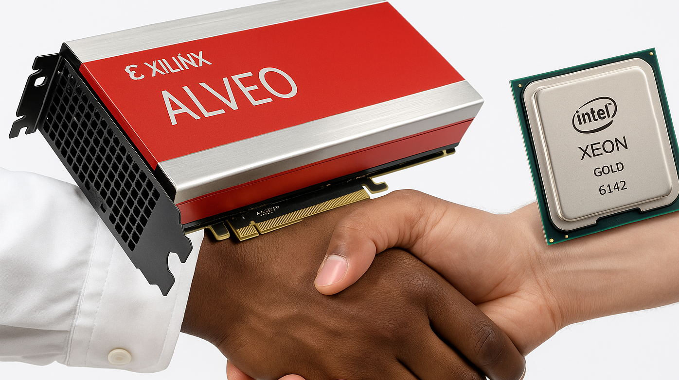
Optimizing Serpens SpMV Accelerator on Xilinx Alveo U280
Presented by:
Aditya Padamwar Northeastern University

Slide 2

Goals of the project
Develop a high-performance Sparse Matrix–Vector Multiplication (SpMV) accelerator on the AMD Xilinx Alveo U280 FPGA.
Leverage the FPGA’s 24-channel HBM architecture to achieve massive memory parallelism and high throughput.
Efficiently process very large sparse matrices by distributing work across many parallel compute units.
Offload SpMV computation entirely to FPGA hardware to outperform traditional CPU-based execution.
Demonstrate how custom, memory-aware FPGA designs can significantly accelerate scientific computing, graph analytics, and large-scale sparse linear algebra workloads.

Slide 3

Details on the Host (Software)
The CPU host software performs all pre-processing, orchestration, and post-processing:
Reading and parsing sparse matrices from (.mtx) files.
Converting matrices into CSC/CSR formats and generating edge lists.
Packing data into 512-bit aligned buffers required by the FPGA.
Initializing the U280 device and loading the xclbin.
Allocating and transferring data to/from HBM buffers.
Validating results by running a CPU reference SpMV.
Reporting performance metrics (runtime, GFLOPS, etc.).

Slide 4
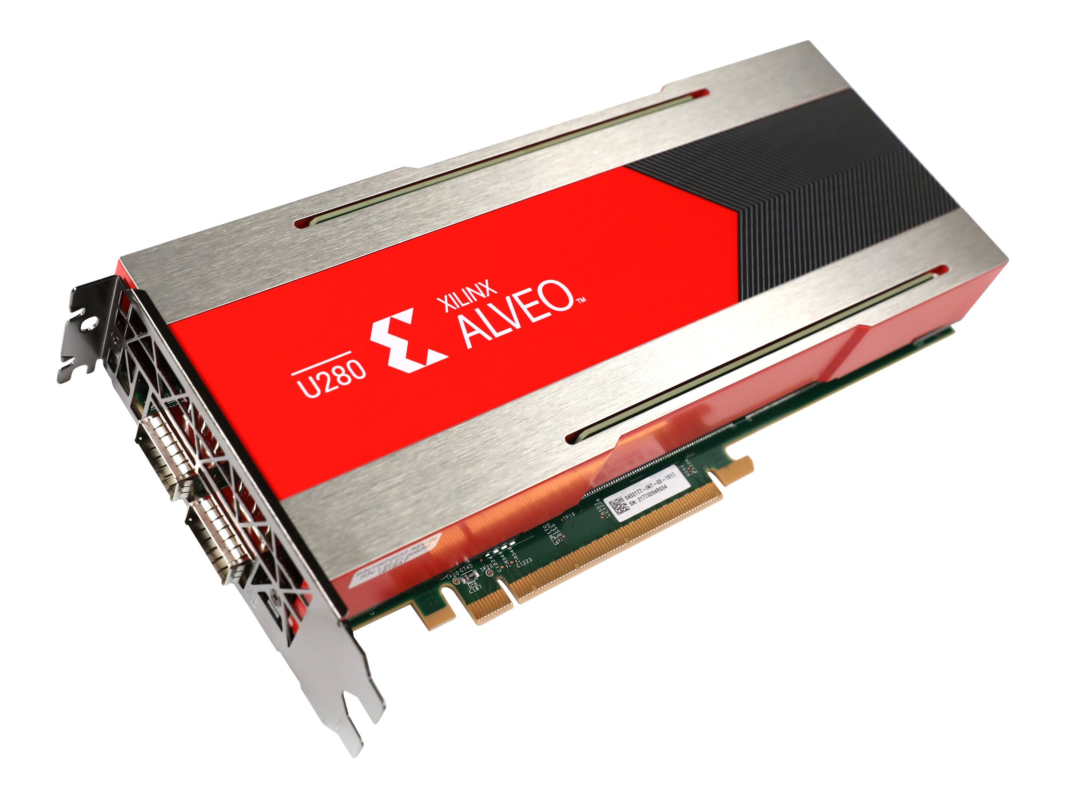
Details on the Kernel (Hardware – Xilinx Alveo U280)
The FPGA accelerator is responsible for all compute-intensive, parallel, and bandwidth-heavy tasks:
Performing the Sparse Matrix–Vector Multiply (SpMV) in a massively parallel architecture.
Streaming sparse matrix data and vectors from HBM memory.
Running 24 parallel processing pipelines that multiply, accumulate, and merge results.
Managing on-chip buffers (URAM/BRAM) for partial sums and intermediate values.
Applying α and β scaling to produce the final vector Y.
Writing the output vector back to HBM for retrieval by the host.

Slide 5
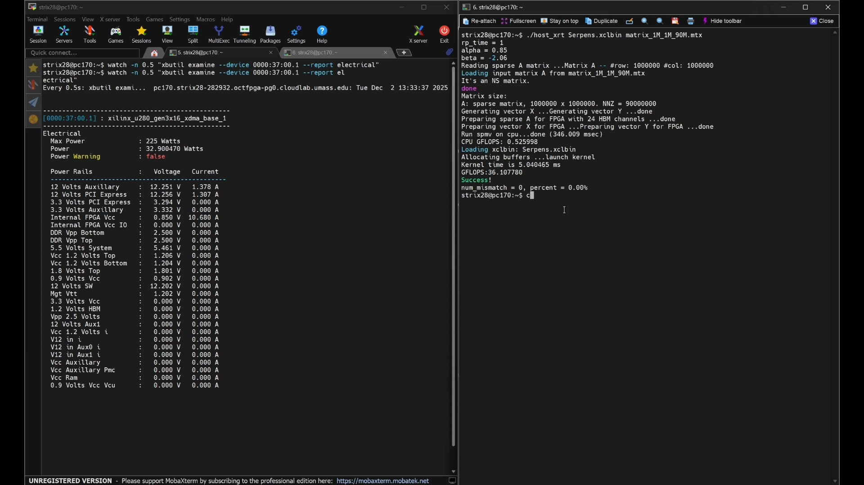
Project Demo with Throughput and Power Metrics and Output Validation

Slide 6
Throughput

Slide 7
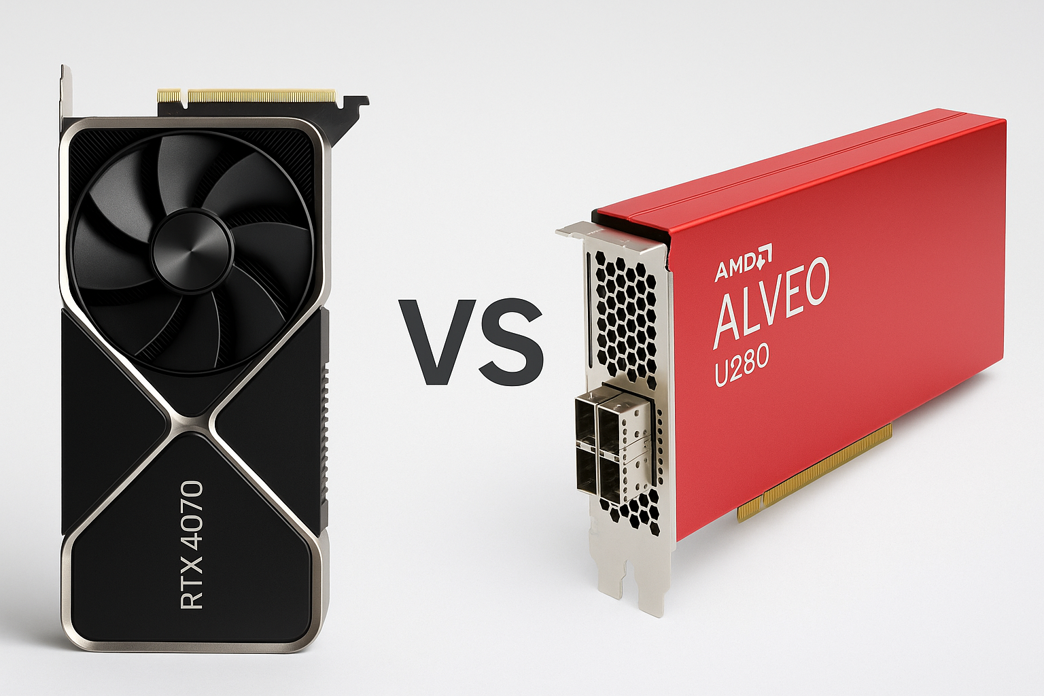
Comparing against a GPU
GPU Kernel (RTX 4070 Mobile @ 130W OC)
My CUDA kernel with warp-reduction, 2D tiling, and vectorization.
Runtime: 3.079 ms → ~58.5 GFLOPS.
Highly optimized for the exact SpMV pattern; strong performance thanks to high clocks and wide SM parallelism.
FPGA Kernel (U280 @ ~33 W)
Pure-HLS implementation of a 24 Channel SpMV Kernel for Xilinx Alveo U280
Achieves ~36–37 GFLOPS at a much lower frequency and lower power.
Key Takeaway
GPU: Wins on raw throughput due to massive compute + high power budget.
FPGA: Wins on efficiency, customization, and memory-architecture control.

Slide 8
Resource Utilization
Resource | Used | Available | Utilization (%)
LUT | 368344 | 1303680 | 28.25
FF | 521693 | 2607360 | 20.01
DSP | 1358 | 9024 | 15.05
BRAM | 595 | 2016 | 29.51
URAM | 960 | 960 | 100

Slide 9
Surprises & Lessons & Future Works
Scaling a congested design is much harder than expected — congestion directly killed timing if I tried at say 250MHz.
Even though the U280 has 32 HBM channels, I could reliably scale only up to 24, similar to Serpens.
Unlike Serpens, I achieved this without TAPA, which made routing and timing more challenging so had to reduce frequency to 150MHz.
The design still had free LUTs/FFs/DSPs, but timing, not resources, became the main bottleneck.
Each HBM channel only provides 256 MB, which is very limiting for large sparse matrices.
Depending on sparsity, a channel can fill up before receiving all the data needed for its matrix region.
To improve the design, I would:
Try and implement Tiling but the small per-channel capacity still restricts how well large matrices map to HBM.
Use a board with larger total HBM capacity, and
Use TAPA to reach higher clock frequency and potentially higher throughput.

Slide 10

Thank You & Questions

